Slide 1
Predicting Consumer Tastes with
Big Data at Gap
Web Data Analytics Group Project
October 2024
Abhishek Bagepalli
Ananth Mohan
Tushar Malankar

Slide 2
Gap - founded in 1969, evolved over time
GAP was founded
Creation of Old Navy
Art Peck becomes CEO
1983
2000
1969
1994
2014
GAP faced some key challenges, as of October 2014
Gap Inc acquires Banana Republic
Sales grow to $14 billion
Market Cap swells to $42 billion
Change in Consumer Preferences
Competition
Loss of Uniqueness
Millennials’ buying habits
Overcrowded Segment
E-commerce
Fast Fashion
Heavy Discounting
Consumers looking to forge a unique identity

Slide 3
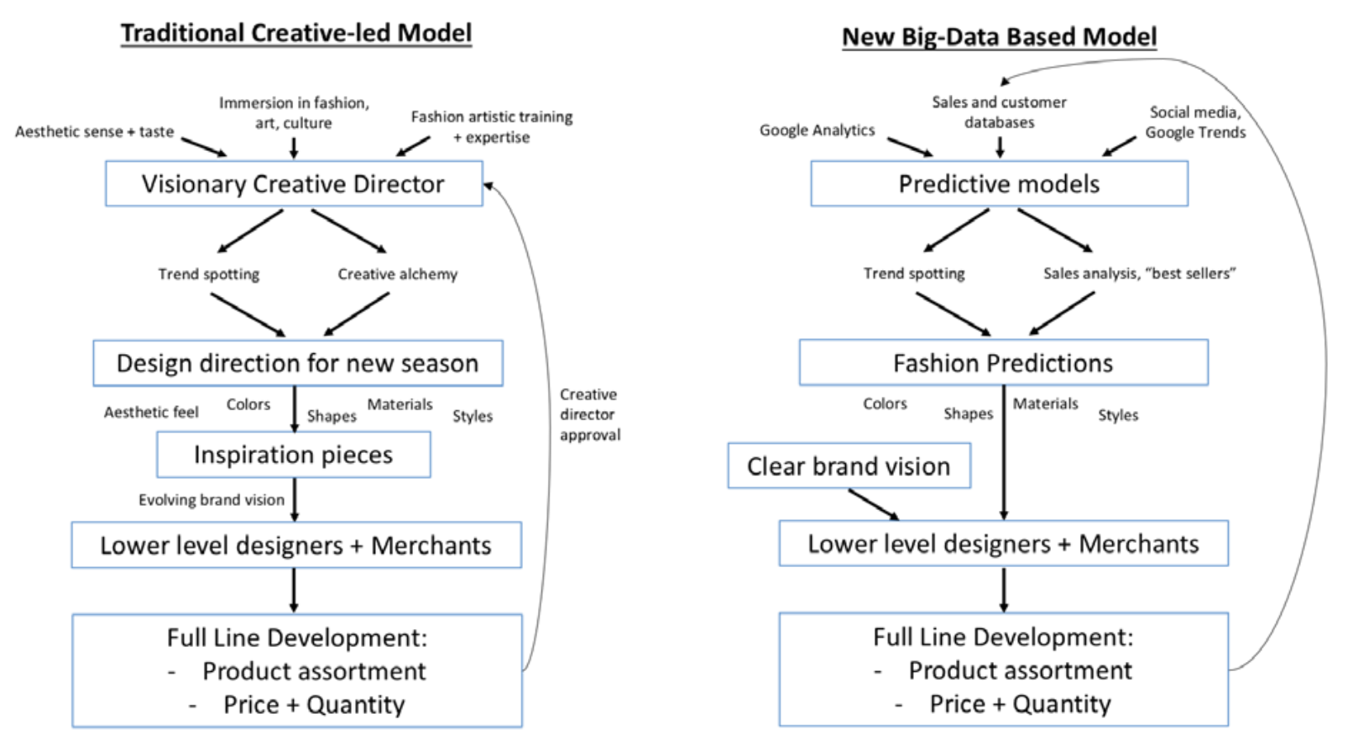
Peck envisioned ‘Product 3.0’ using Big Data
2015
Art Peck fires creative directors and moves to a completely data driven approach

Slide 4



We aim to address the following…
Was replacing creative directors beneficial for GAP?
How to design a data-driven analytical approach for creative design in the modern age?
How GAP can balance Science and Art in Marketing?

Slide 5
Our Approach

Slide 6
There are several approaches we can take with Big Data, we limited the presentation to a few of them
Challenge
Web Data helps to understand
Implementation
1
Changing Consumer Preferences
Sustainability, Personalization
What are people looking for?
Browser Search Trends
Keyword search
Competition & Discounting
Overcrowded Segment, E-Commerce, Fast Fashion
What is the competition doing?
Competitor Product Portfolio
Amazon Product Listing & Discounting Comparison
2
GAP’s Loss of Uniqueness
More Classic than Trendy
What do customers think about GAP?
Reddit Sentiments
Amazon Review Sentiments
3
Notes:
There are several problems we could solve, but we focused on the key issues GAP was facing and considered what data could solve

Slide 7
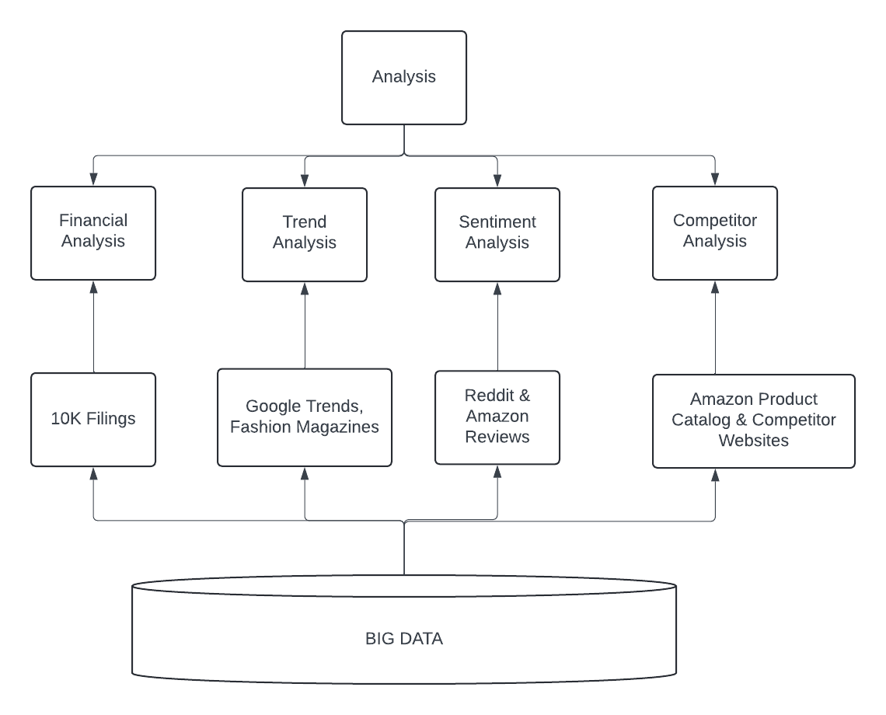
We used the following analyses…
Notes:
We scraped and analysed 10-K Filings data to understand the effect Product 3.0 on key business metrics
Trend analysis using Google Trends and Fashion Magazines
Reddit & Amazon Reviews to understand sentiment towards GAP products
Amazon & Competitor websites to understand product portfolio

Slide 8
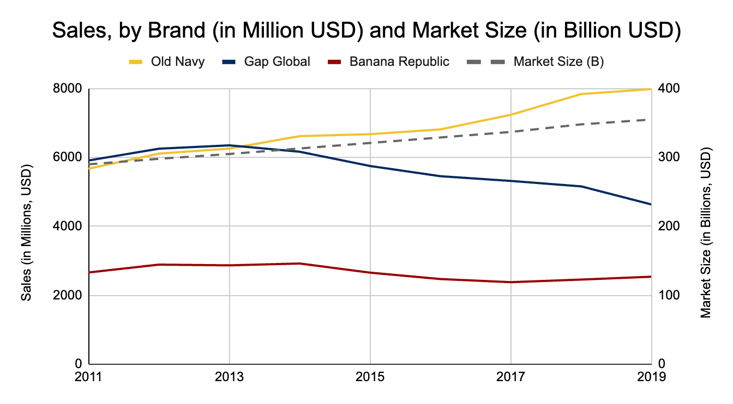
Financial Analysis - 10K Filings
Was Peck correct in firing his creative directors and replacing them with a big data- driven creative process? Why or why not?
Apparel Market Size grew at an average of +2.5% from 2011 to 2019*
Old Navy grew at a rate more than market size growth
GAP and Banana Republic stayed flat or went down
Product 3.0
Big Data driven approach didn’t help to change the course for Gap and Banana Republic, but Old Navy grew. Economical fashion brands like Old Navy might benefit more from real-time data, while Banana Republic, a premium brand, may still need a touch of traditional creative influence
* Source - Global Data - Market Size of Retail Clothing in US

Slide 9

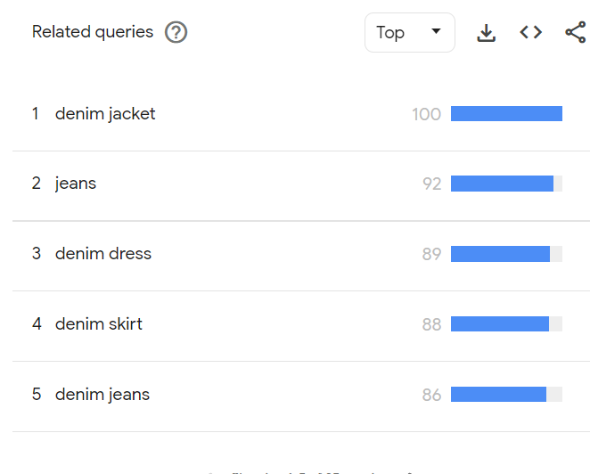
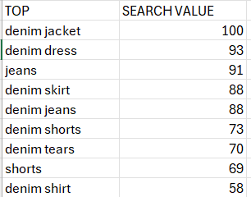
Optimize Product Lineup Based on Consumer Preferences
Extract
Data Available | Analytical Solution | Business Impact
Fetching trend search values from google trend using python’s pytrend library | Using high-volume search keywords as indicators of potential fashion trends. | Companies can shape their product lineups based on search trends, as these trends reveal consumer interest. For example, the data indicates that denim jackets are a trending topic within the denim category, suggesting a strong demand for this product. Google Trends also provides search values on a regional level.

Slide 10

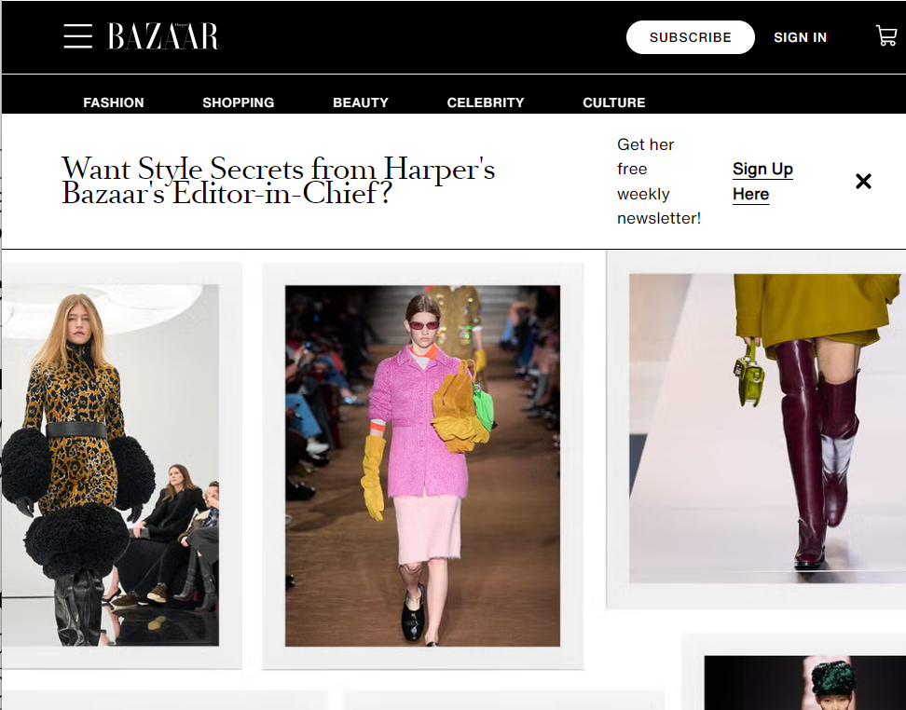
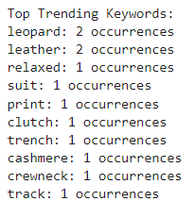
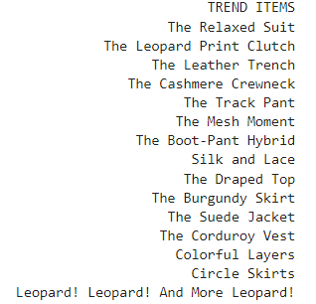
Trend Analysis - Identify Emerging Fashion Trends
Extract
Keywords
Data Available | Analytical Solution | Business Impact
Scrape using Selenium, BeautifulSoup for scraping the fashion suggestion make by fashion blogging websites like Vogue , Elle and Harpers Bazaar | Predicting possible Emerging Trend Identification through Scraping | By scraping fashion magazines and blogs, brands can identify emerging trends and important keywords. This data-driven approach allows manufacturers to understand current consumer interests more accurately than intuition alone. Eg. Gap can release more leopard based clothing in their next lineup

Slide 11

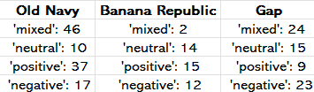
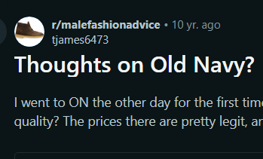
Sentiment Analysis - Reddit
Extract
Data Available | Analytical Solution | Business Impact
Scrape for comments on popular posts from each subreddit about all three brands of Gap Inc | Sentiment Analysis | Aids the brands to better understand consumer sentiments and make informed business decisions.
 | Key Insight | From the sample analysis, we see that Gap has the most negative sentiment while Old Navy has a positive sentiment overall. This is reflected in the net sales of each brand as well.

Slide 12

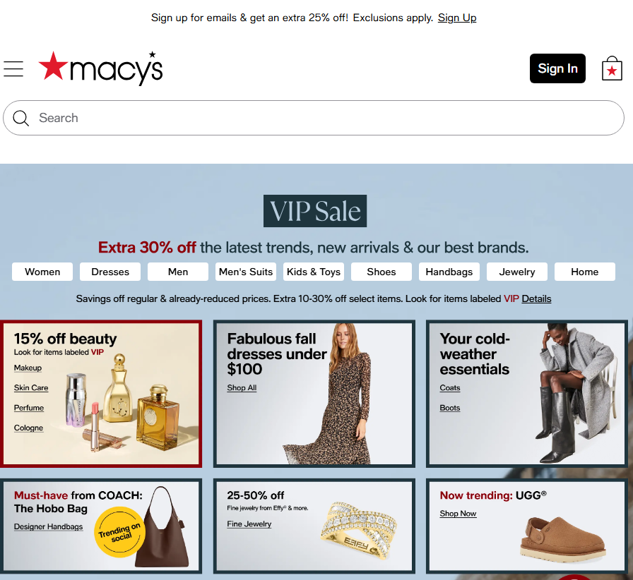
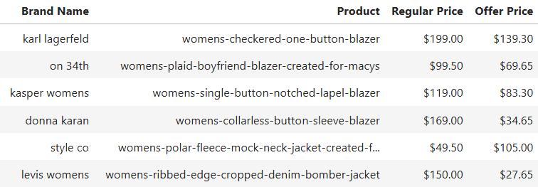
Competitor Analysis - Best Selling Product Listing & Discounting
Extract
Data Available | Analytical Solution | Business Impact
Scrape for product listings for competitor companies of interest and related categories: Brand Name Product Name Regular Price Offer Price | Competitor Stock Analysis | Macy’s listings provide an overview of bestselling products. Understanding competitor stock performance helps identify industry trends, market positioning, and potential shifts in consumer preferences.
 | Key Insight | From the sample, we found that 83% of best sellers were products on which discounts were being offered. Furthermore, ALL of these discounted items had a discount of 30%.

Slide 13

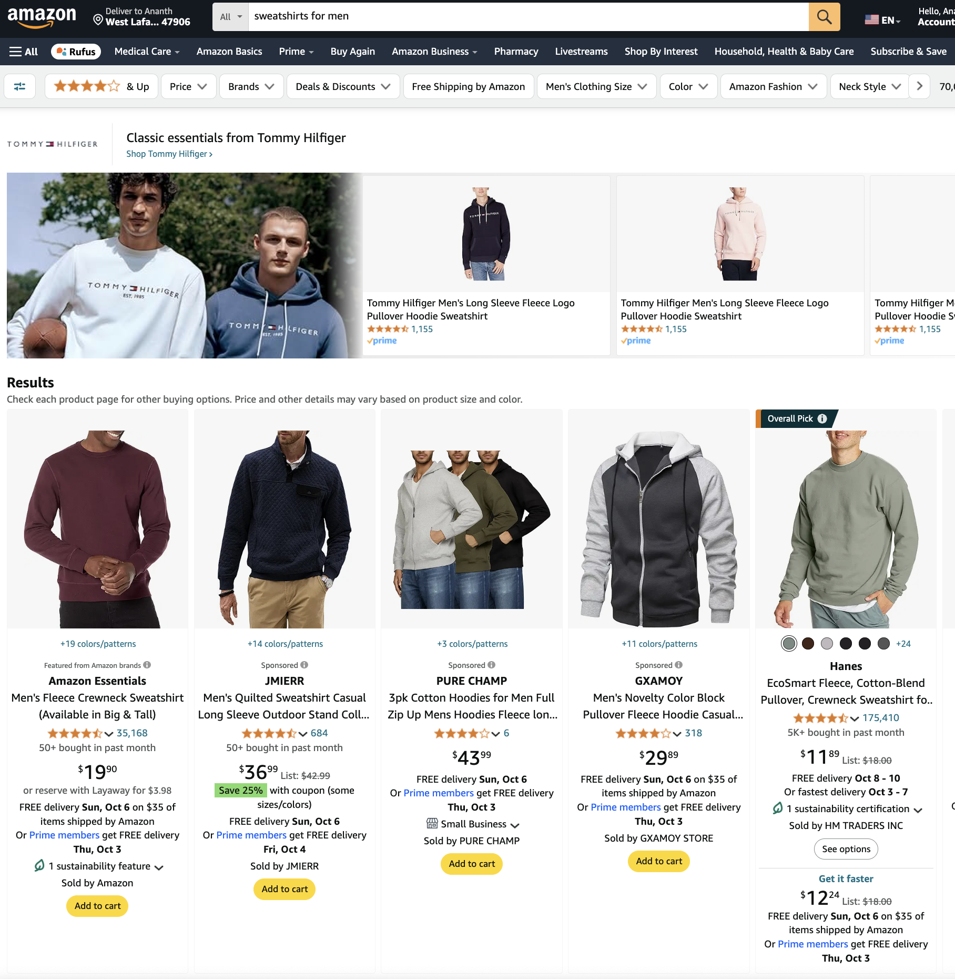
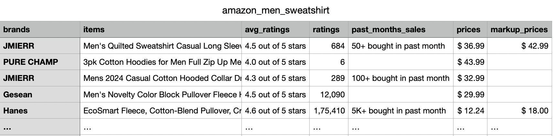
Competitor Analysis - Competitor Product Listing & Discounting
Extract
Data Available | Analytical Solution | Business Impact
Scrape using Selenium, BeautifulSoup for product listings for competitor companies of interest and related categories: Item Average Rating Number of Ratings Past Month Sales Price & Marked-up Price | Monitor competitor product portfolio | Amazon listings can be used to understand the different type of products (shirts, jeans) for a competitor and also top brands in each category
 | Sales analytics | Amazon displays range of the number of units sold in the last month. Time series analysis of this data can help to understand consumer different products sold over time and it’s seasonal variations
 | Pricing analytics | Running a regression analysis to understand impact of discount, price on sales

Slide 14
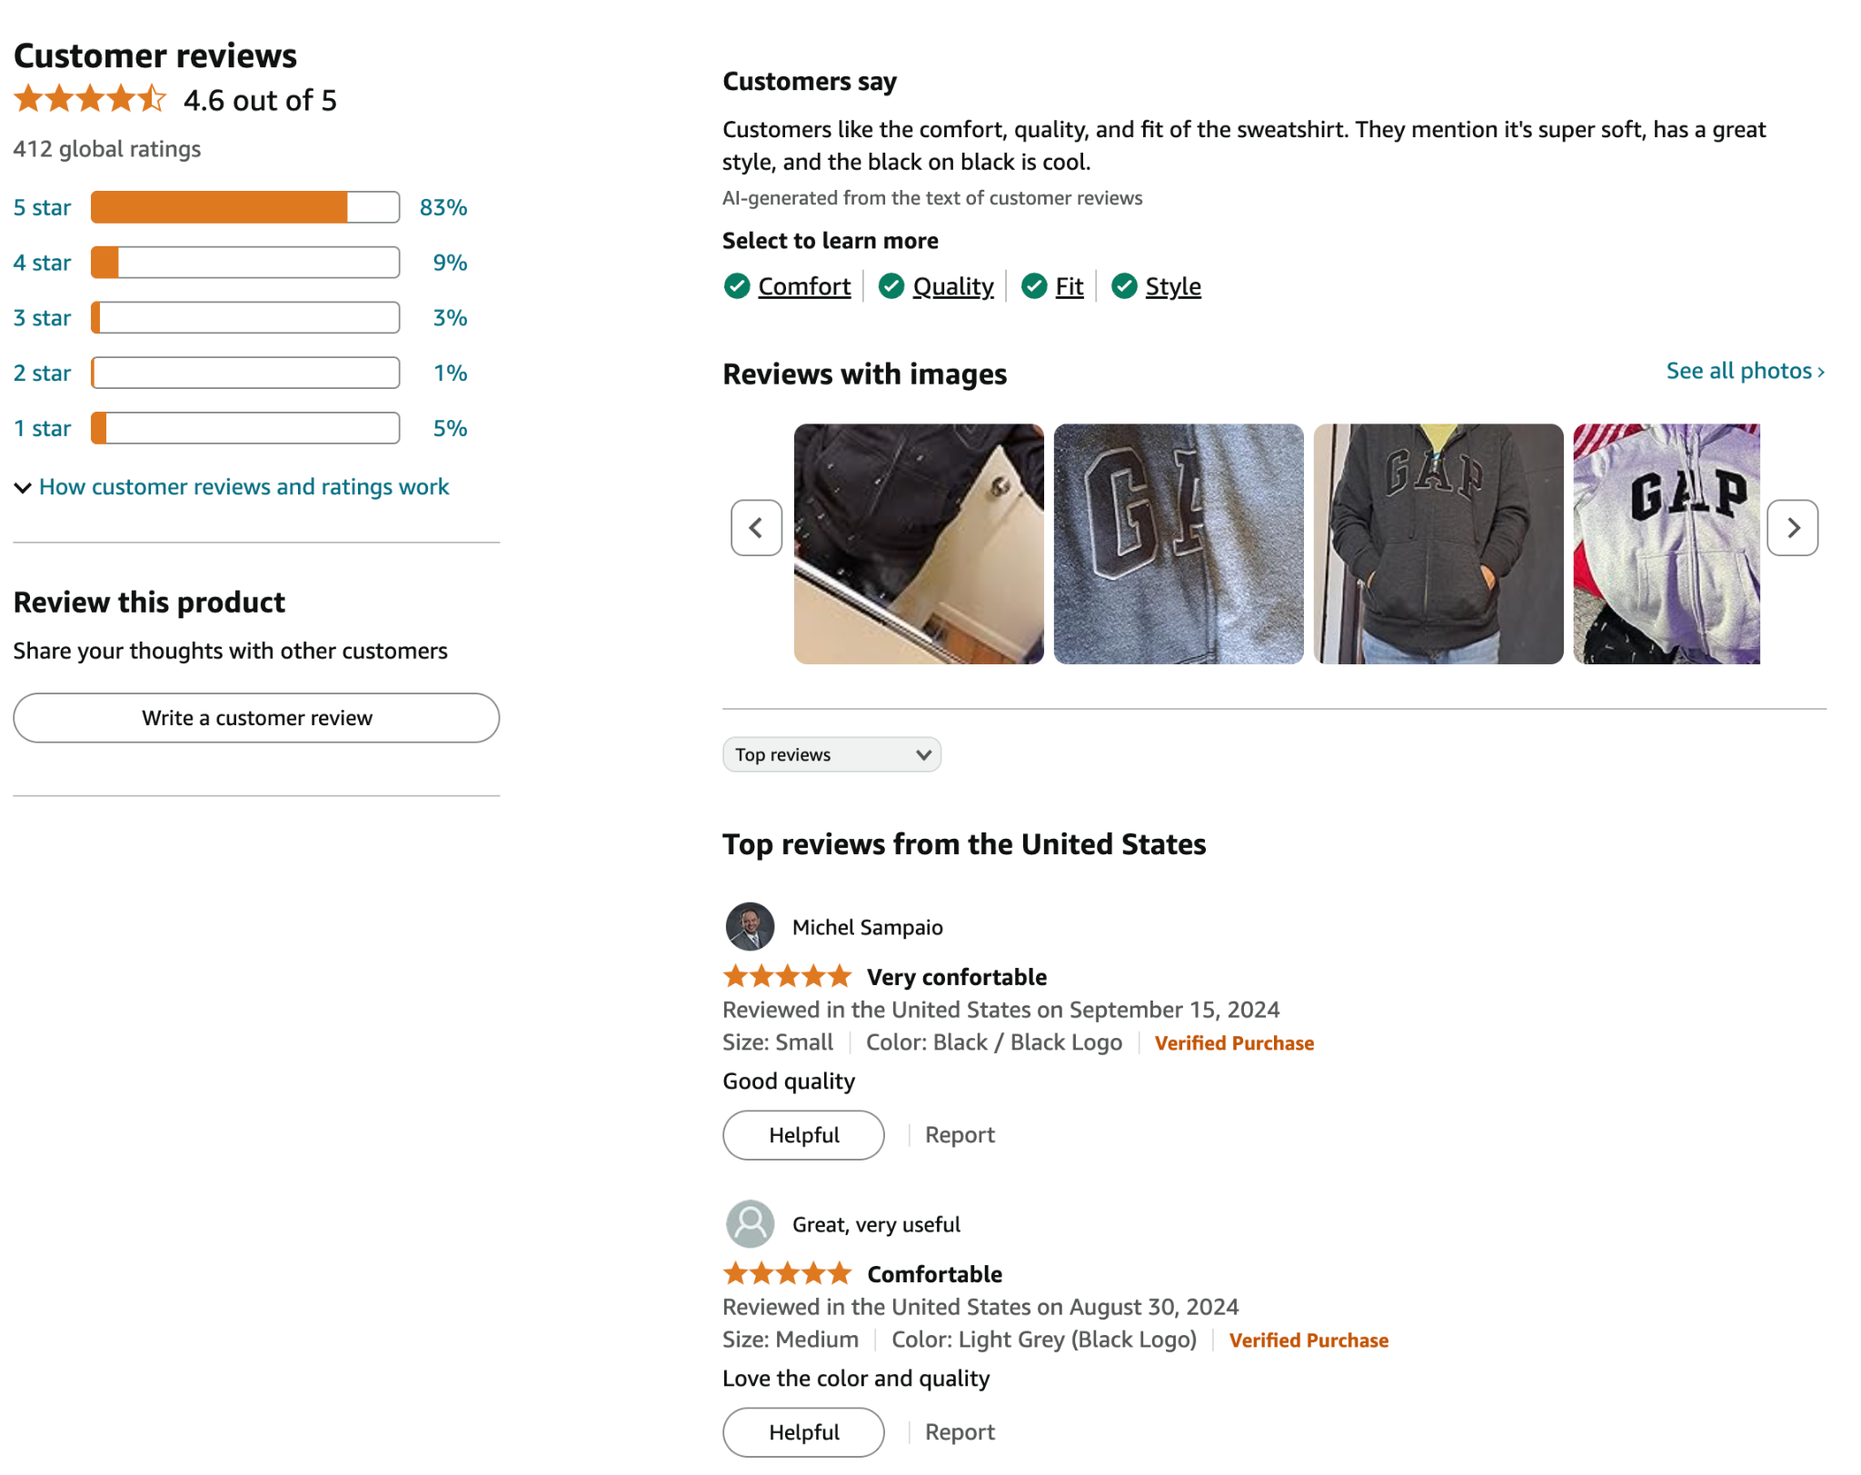
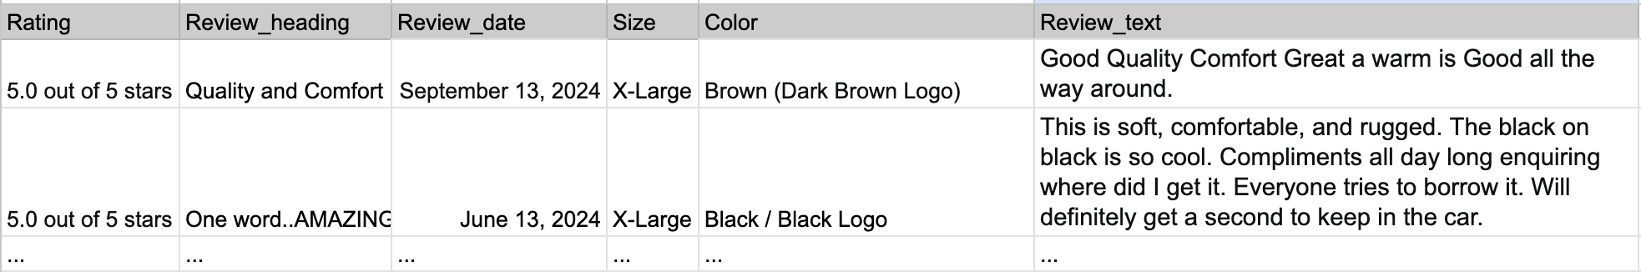
GAP Product Reviews and Sentiment Analysis
Extract
Data Available | Analytical Solution | Business Impact
Scrape using Selenium, BeautifulSoup for reviews of products sold by GAP: Rating Review Heading Review Date Size, Color Review Text | Text analysis | Use LLMs or text analysis to monitor user feedback which could be used for product improvements and design ideas
 | Sentiment analysis | Use LLMs or NLP to understand user reaction to a product and what drives those

Slide 15
Art vs. Science
in Marketing

Slide 16

ART
SCIENCE
Maintaining Brand Identity
A/B Testing for Ad impact
Creating Compelling Ad Campaigns
Demand Forecasting
Capturing Emotional Interest
User Segmentation
Aesthetic Creation
Data Driven Ad Placement

Slide 17
Combining Art and Science
TREND AND IDENTITY
Analyzing clickstream data reveals trending products which must be highlighted in the ads , Ad designers can use their creative to decide the best way to present them to the audience.
03
DESIGN APPROACH
Instead of relying on intuition, A/B testing allows us to compare between Ad strategy approaches and determine which one delivers the best results..
01
02
ADS
Data analytics can identify potential customers, while creativity comes in how you reach to these customers.
Data informs past and present decisions. Innovation thrives on creativity and action to shape the future

Slide 18
Limitations

Slide 19
Limitations
Trend Analysis |  | Search does not equal demand Short term fluctuations in searches
 | Fashion Magazines | Editorial bias Delayed reporting Focus on high fashion
Sentiment Analysis |  | Hive mentality of users tends to sway majority opinion towards one side
 |  | Negative comments feel louder online
Web Scraping | Website network security
Competitor Analysis | Scraping Competitors website is a superficial knowledge of brand’s creative and marketing strategy.

Slide 20



Does the big data approach work for all three of Gap Inc.’s primary brands: Old Navy, Gap, and Banana Republic?
Fast fashion at an economical rate
Mid-tier apparel brand focusing on classic
Premium brand which needs creative touch
Data guides trend-driven, high-volume product lines, keeping Old Navy relevant to mass-market tastes
The creative director plays a key role in blending timeless styles with fashion trends, and ensuring brand consistency across both digital and physical platforms.
Big data primarily drives operational decisions like pricing and stock management.
A creative director is vital for Banana Republic's luxury market, as big data can't fully capture the brand image, exclusivity, and aesthetic refinement.
While creative vision remains irreplaceable, data aids customer insights and marketing

Slide 21
Thank You

Slide 22
Appendix

Slide 23
Data Sources
10K Filing for Gap Inc. - c.gov/Archives/edgar/data/39911/000003991119000023/fy201810-k.htm
Reddit Link for Sentiment Analysis - https://www.reddit.com/r/malefashionadvice/comments/dtotnr/the_gap_ceo_is_leaving_the_companys_stock_lost/?sort=top
Link to Macy’s - https://www.macys.com/shop/womens-clothing/new-womens-clothing/Product_department,Sortby/Jackets,BEST_SELLERS?id=68514
Amazon link - https://www.amazon.com/s?k=sweatshirts+for+men
Harpers Bazaar - https://www.harpersbazaar.com/fashion/trends/a46826009/fall-2024-trends/
Vogue Magazine- https://www.vogue.com/article/fall-shopping-list-editor-picks-2024
Market size of retail clothing in the US - https://www.globaldata.com/data-insights/retail-and-wholesale/market-size-of-retail-clothing-in-us/
Elle Magazine - https://www.elle.com/fashion/trend-reports/a46805342/fall-2024-fashion-trends/
Google Trends - https://trends.google.com/trends/explore?date=today%203-m&geo=US&q=denim&hl=en
Notes:
We scraped and analysed 10-K Filings data to understand the effect Product 3.0 on key business metrics
Trend analysis using Google Trends and Fashion Magazines
Reddit & Amazon Reviews to understand sentiment towards GAP products
Amazon & Competitor websites to understand product portfolio

Slide 24
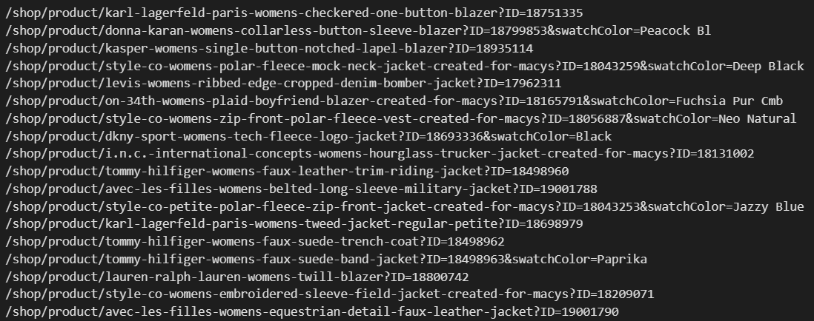
Web Scraping - Macy’s

Slide 25
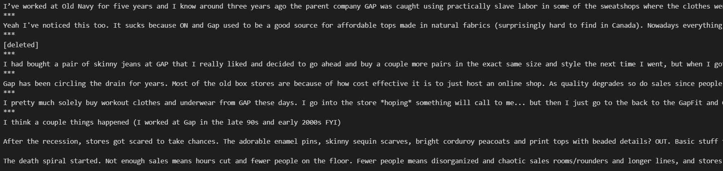
Web Scraping - Reddit

Slide 26
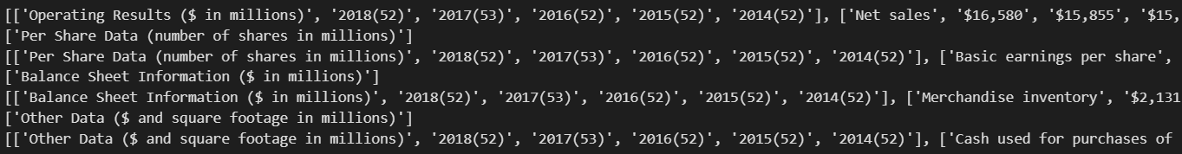
Web Scraping - 10K Filings

